Slide 1
Water Filtration System using 3d Printing
Team JAY -
Astha
Janmejay
Yashasvi

Slide 2
Introduction
Our research work basically revolves around a model that we made with the help of 3D printing processes and its development tools.
The model that we have made is a water filtration process that basically purifies the water which consists of macro impurities as we all know that pure water is very important for our health and overall well-being.
The main motive and innovation of our 3D printed solid model is its flexibility and scalability. In our research we have tried to make the cap of the bottle universal so that it can be used in maximum types of way and thus its usability increases.
We have used the two basic development tools of 3D printing that includes fusion 360 and ultimate Cura, the methods and the materials we have used will be discussed in this presentation along with the methodology of designing the bottle which will consist of the filtration equipment.

Slide 3
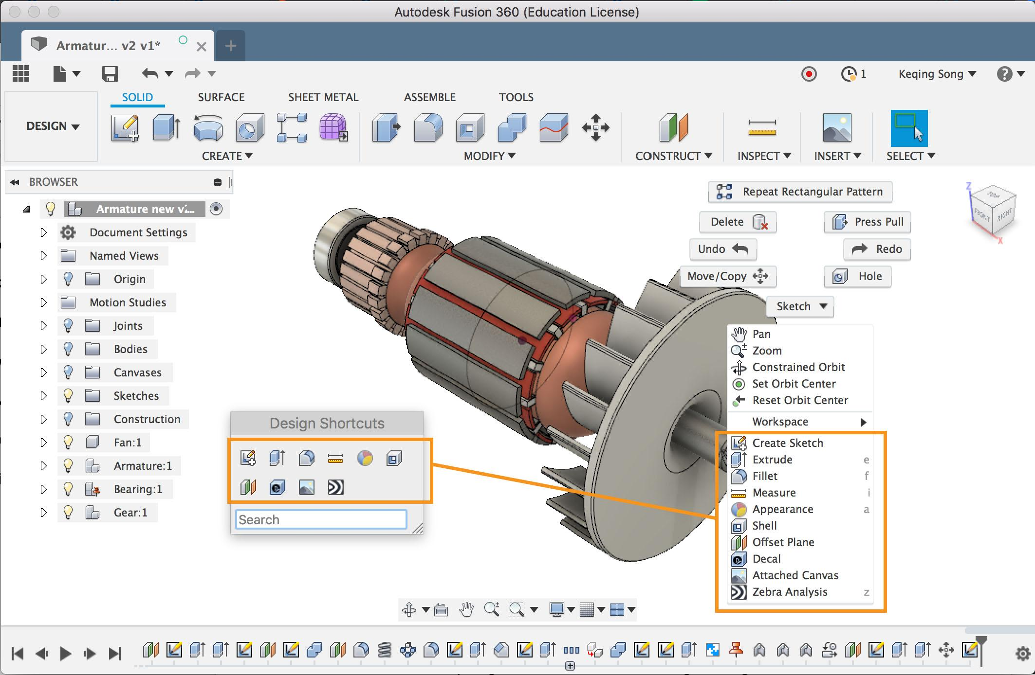
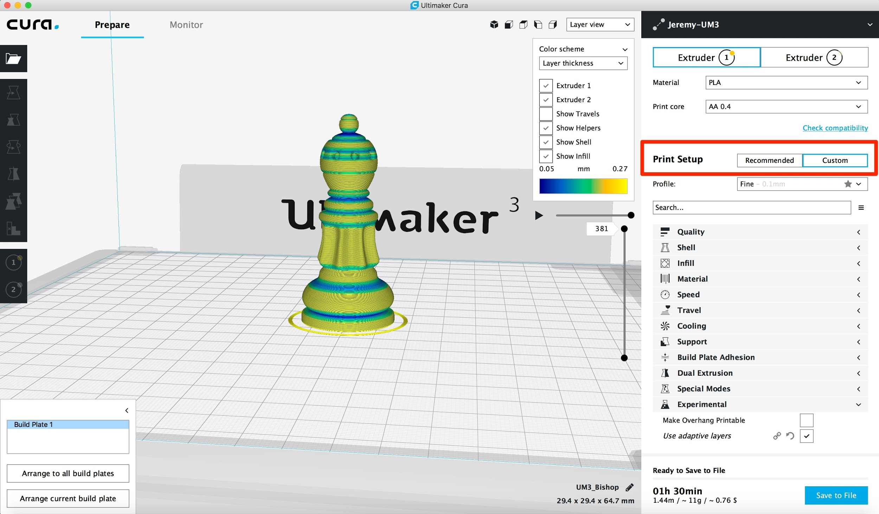
Overview of Software Used
Fusion 360
Fusion 360 is an excellent tool for modeling 2D and 3D objects for very precise dimensions, but there are other features such as the ability to animate designs, to render objects in real time, simulation of different loads, and most important preparing models for 3D printing
Ultimaker Cura
Cura is a software which is used for slicing 3D models into layers. It is an open-source software, it is probably the widest used software in the 3D Printing and Manufacturing Market.

Slide 4
Water Filtration Process
Some filtration processes are more efficient at removing particles and contaminants than others. Here's a quick overview of each type of water filtering method that can be used in our project.
Activated Carbon: By chemically reacting to the water which is placed into the device, carbon prevents pollutants. Some only extract chlorine efficiently whereas others eliminate more harmful chemicals, like lead or mercury .Carbon filters are generally sold in markets in the form of grains or block.
Distillation: This process evaporates water by bringing it to extremely high temperatures. The vapor is then distilled away into healthy drinking liquid water. Distillation extracts minerals, microorganisms, and chemicals which have an increasing boiling point.
Ion Exchange: Ion exchange uses a resin to substitute toxic ions with less harmful ones. As it has the capacity to substitute magnesium and calcium with sodium, ion exchange is also utilized for softening of water.

Slide 5
Water Filtration Process
Reverse Osmosis: Reverse osmosis involves pushing water via a semipermeable membrane. Since this procedure may cause blockage to molecules which are bigger than water, it is not possible to eliminate pollutants with larger molecules, like chlorine.
Carbon Block: Block-shaped filters that are made of crushed carbon particles are carbon block filters.. The pace at which water flows through these filters directly affects their efficiency level.
Granulated Carbon: These filters use tiny particles of carbon to purify water

Slide 6
HOW CLEAN WATER IS IMPORTANT FOR THE ENVIRONMENT?
When it comes to the importance of clean water, it plays a very vital role in the proper functioning of the environmental cycles as well as the working of the human body.
Some of the points that states very clearly that why everyone needs clean drinking Water:
PROVIDE NOURISHMENT-As from our early life, we have heard that Water is said to be another name for life. So it's a fact that water has many nutrients and humans need them to uplift the organ health and allow the blood to maintain the proper flow of blood and transport of various nutrition.
THE PREVENTION OF DISEASES- If we do not consume clear and pure water in our daily life then it can lead to various fatal medical conditions that includes typhoid hepatitis A as well as Cholera. Contaminated water according to the recent research has led to many chronic diseases that have increased the mortality rate in the recent decades. Clean water is not just essential for being safe from diseases but it also helps us to maintain good health.

Slide 7
HOW CLEAN WATER IS IMPORTANT FOR THE ENVIRONMENT?
HELPING IN GETTING RID OF TOXINS- Body creates and generates various different types of toxins on the daily basis of food that we consume and our daily regular habits. Tense in order to flush it out from our body.
FOR AGRICULTURE AND FOOD PRODUCTION- The basic requirement for the food to grow is water that is provided through irrigation in the fields, if the water is contaminated then there will be a negative impact on the crops and the agricultural fields that can lead to major hazards in the coming times. Hence it is important that clear water is irrigated in the crop fields and yards.
IMPROVED SANITATION FACILITIES- Clean water is not just required for drinking but it is also required for the purpose of sanitation. In some cases it was seen that the cooking and the cleaning was not done with proper clean water hence the diseases were spreading and degradation of good health was happening.

Slide 8
HOW DOES A CHARCOAL FILTER WORK?
The charcoal utilized in water filters is not similar to what is used in BBQ bricks. Water filters utilize activated charcoal, which is typically pressed into a solid block or sold as granules.
Activation of Charcoal is done at temperatures above 1000F by a method of extremely heating the charcoal without oxygen. The porosity of the activated charcoal is the main factor in making charcoal water filters so potent.
Activated charcoal, via the adsorption mechanism, works. In activated charcoal, the pores raise the surface area of the charcoal up to an incredible 2000 square meters per gram me, dramatically increasing its efficiency of adsorption.
The reason why activated charcoal has become such a useful accessory for water filters is that it is organic and efficient in extracting many water pollutants, such as toxic organic compounds and chlorine, without the use of chemicals or the treatment of contaminants from salts and minerals.

Slide 9
WHY IS CHARCOAL THE BEST WATER FILTER?
Minerals remain: Drinking water is not only made from oxygen and hydrogen, there consists of a lot of different elements that contribute to the water composition, in addition to unpleasant chemicals and contaminants.
It makes it healthier: safer. Activated charcoal can put vital minerals like magnesium, calcium and iron back into the water in order to improve the quality of the water.
It enhances the taste: It enhances the taste of water and prevents chlorine and ugly odors. Chlorine is necessary to ensure that our water supply is clear of bacteria and viruses; we do not need to consume chlorine / a disinfectant, nevertheless
It is cheap: For your home, several water filters can be a costly, but required, investment. But at the other end, charcoal filters are relatively cheap to make, and these savings are handed down to the user.
It is easy to maintain: Although the charcoal is already used, the filters need to be checked, the new components are cheap and easy to assemble and attach. It is essential to alter your carbon filter approximately each six months.

Slide 10
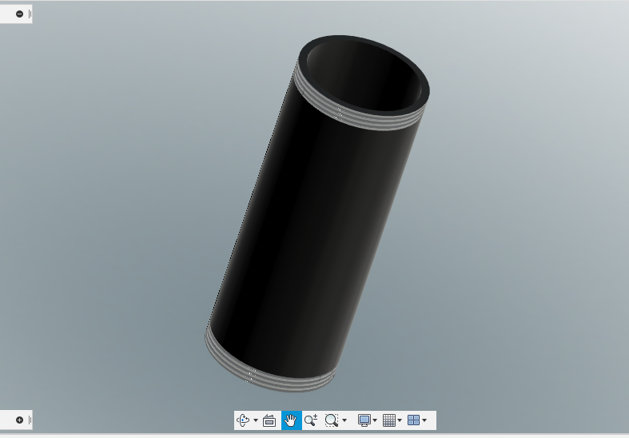
FUNCTIONING OF 3D PRINTED WATER FILTER
The main model of the filter is the cylinder which has been shelled and the bottom surface has some holes from which the water may enter or pour out depending on the orientation of the filter and the position. Inside the cylinder, there is another cylindrical disk which acts as a sieve due to very tiny holes,

Slide 11
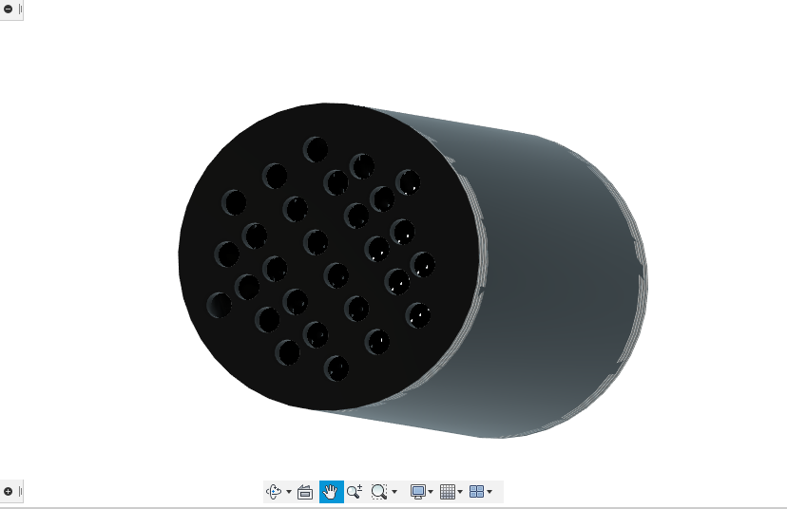
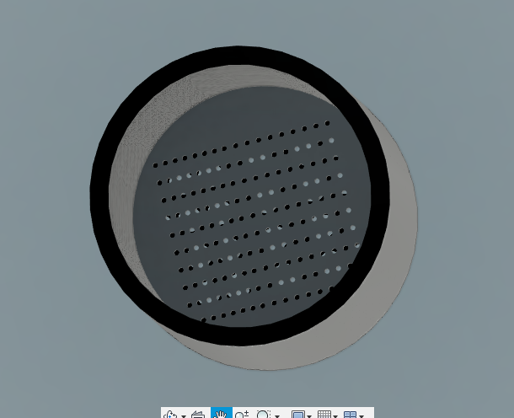
which only permit some amount of water to go through which will then get filtered through the Water Filter Material that is being put inside the cylinder The cylinder has threads on either side to incorporate the universal nature of this filter and so that the caps can be attached to the filter simply by tightening the cap.

Slide 12
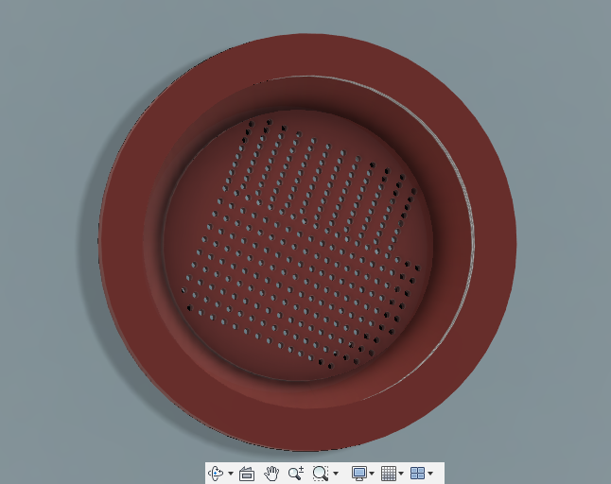
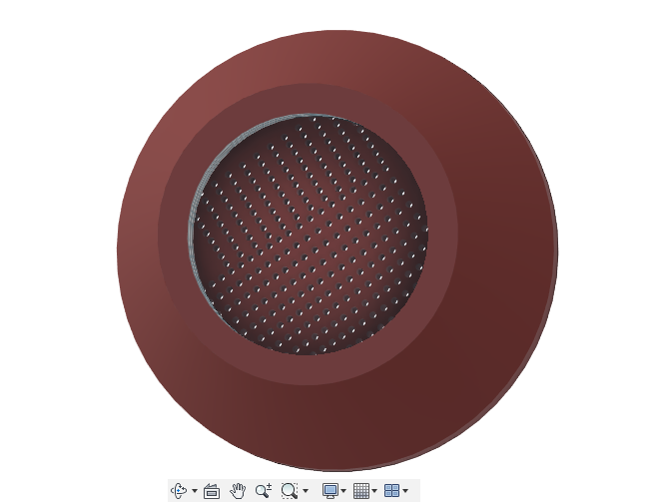
The caps have been designed to attach to the cylinder as well as to the apparatus for which the cap has been made. The caps also have cylinder discs with small holes which act as a sieve same as in the main cylinder. The caps which we have made as examples are of a pipe and plastic water bottle. The water bottle cap will attach directly to the cap and then to the cylinder

Slide 13
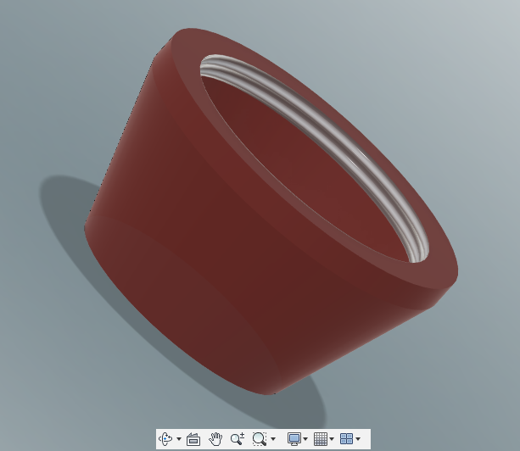
The Cap also has threads on both sides so that it can be attached to the bottle as well as the container.

Slide 14
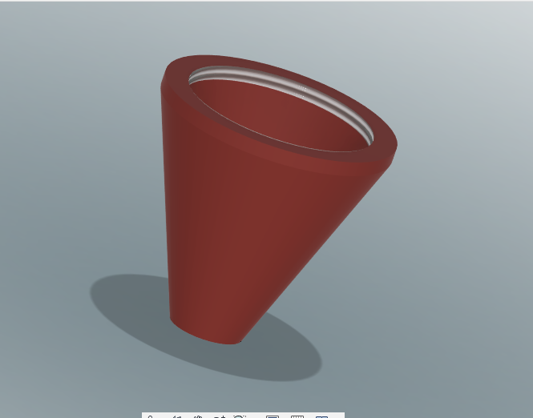
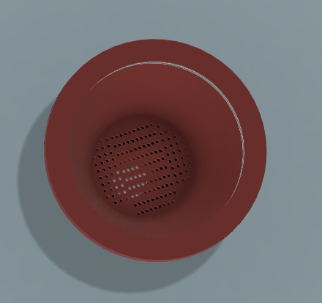
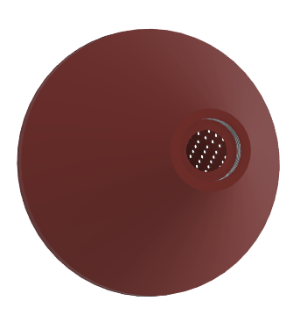
The pipe cap has threads as well a smaller hole so that the rubber can fit perfectly in the cap with no gap

Slide 15
Results
With the usage of different development tools and additive manufacturing software, we successfully made our Water Filtration model. The main model of the filter is the cylinder which has been shelled and the bottom surface has some holes from which the water may enter or pour out depending on the orientation of the filter and the position. Thus, due to its portability as well as affordability it can be used by the majority of the population in a variety of purposes and in any form. In our research we have shown how the consumption of contaminated water.

Slide 16
THANK YOU

